Slide 1
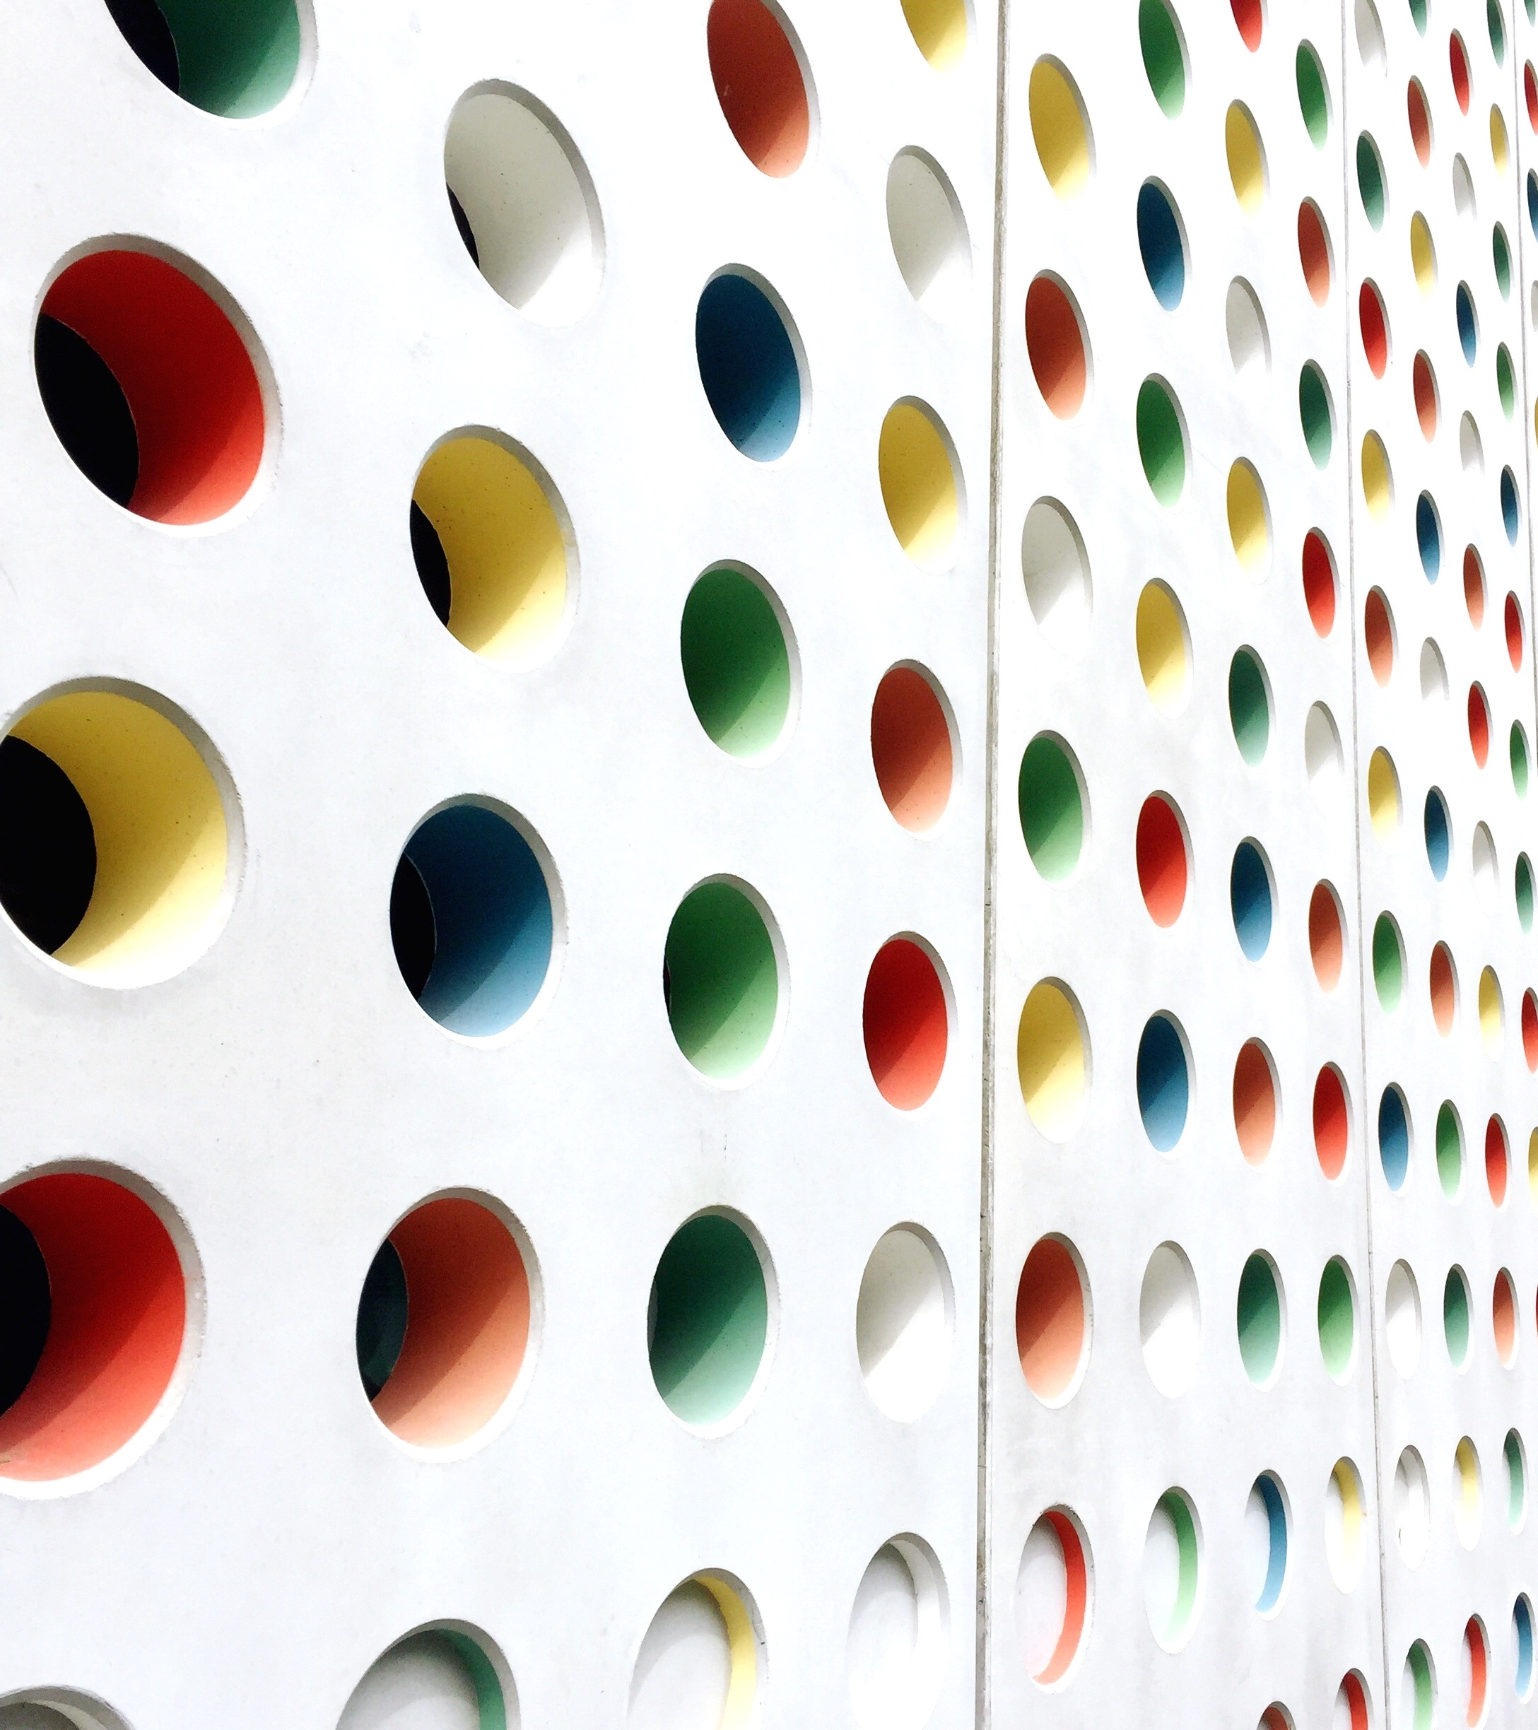
Temperature and humidity sensor
Achiriloaei Ioana-Isabela

Slide 2
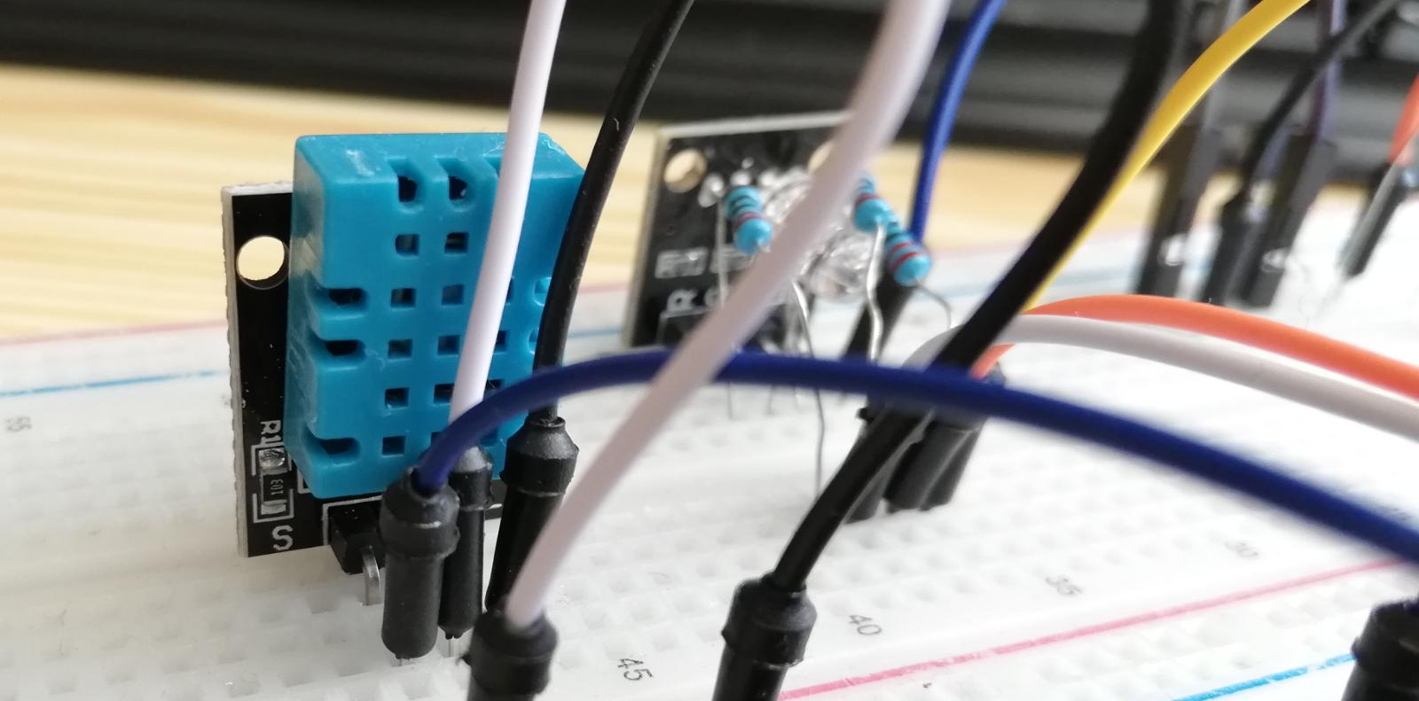
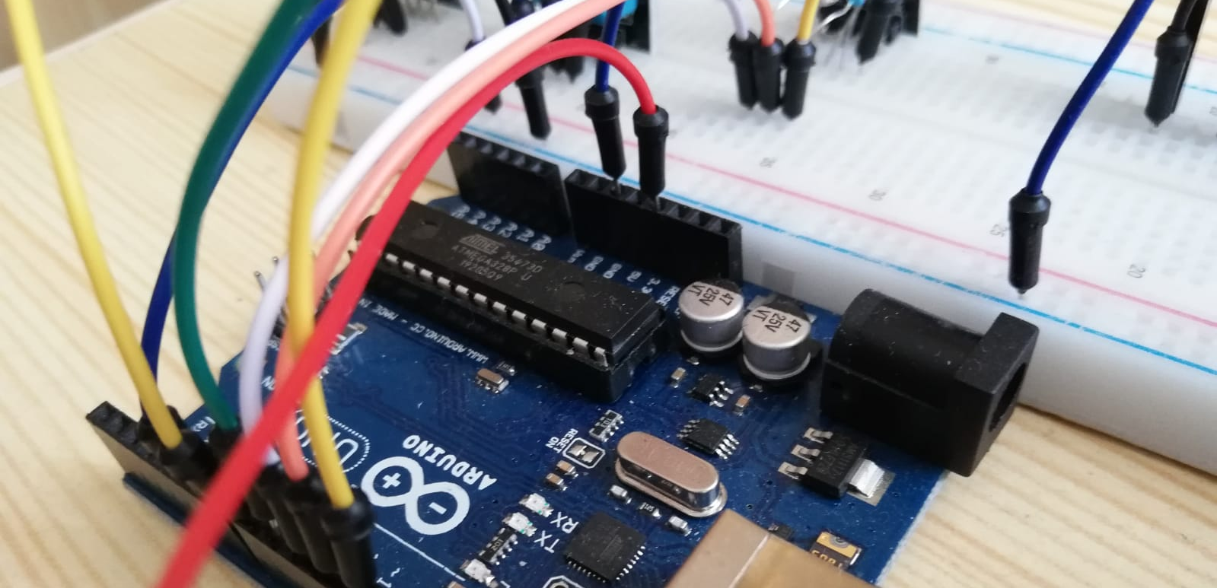
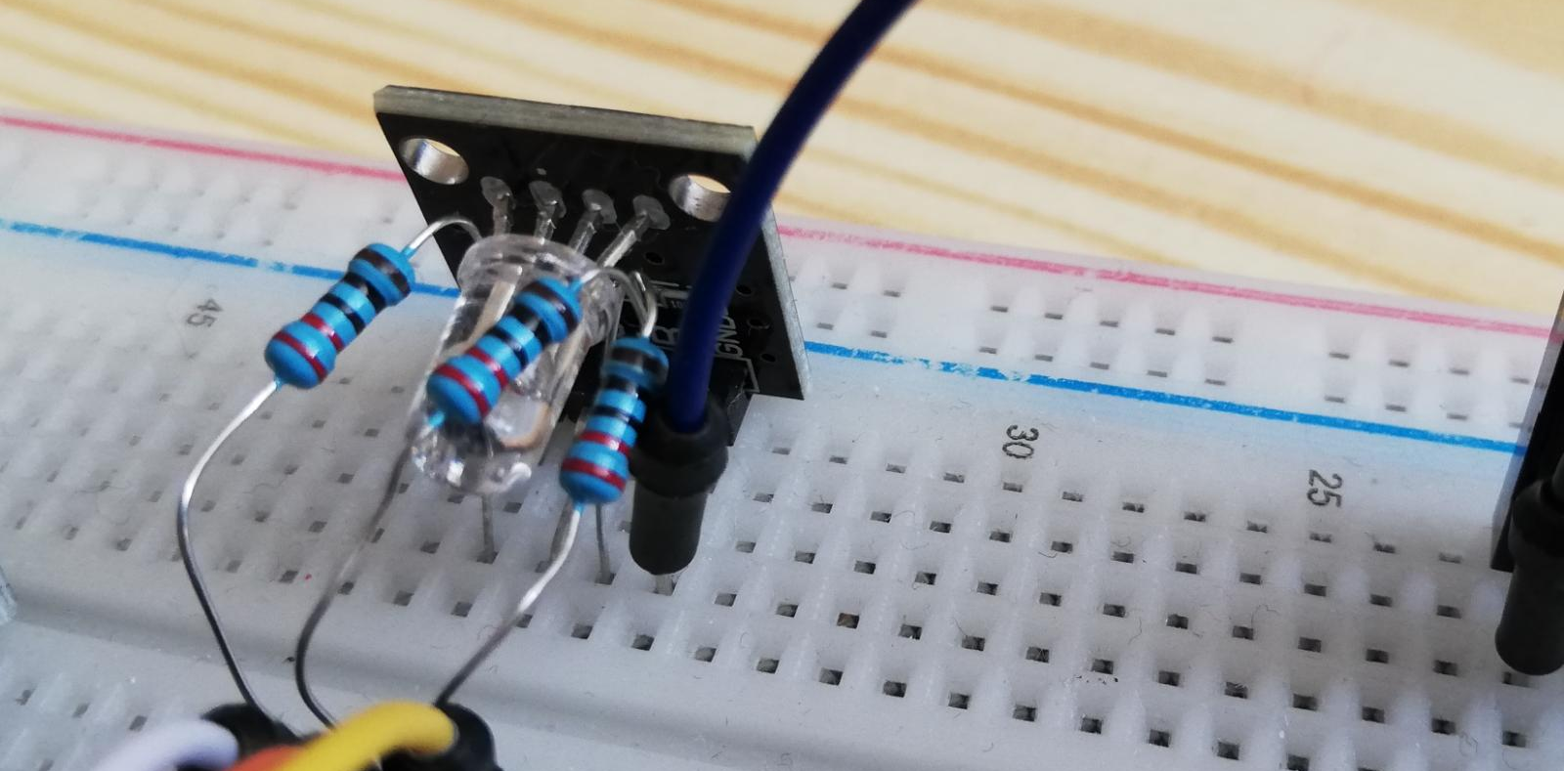
Components
In this project I wanted to see how to interface Arduino board with different sensors and for this we need these components:
▪ Arduino Uno R3
▪ DHT11 sensor
▪ Led RGB
▪ Resistors 220 Ω
▪ Breadboard and Jump Wires

Slide 3
Specifications
My sensor has 3 pins and it's fitted on a board:
▪GND pin to the ground of board
▪DATA pin to Arduino pin number 7
▪VCC pin to 5 volt of board
RGB LED:
▪ cathode will be connected to the ground and the 3 anodes will be connected through 220 Ω resistors to 3 digital pins on the Arduino Board
With DHT11 sensor I will measure the temperature and humidity in a room and with the RGH led I will know if the temperature in is normal or too high.
When the led is red that means the temperature is over 25 ºC, when is green then it’s about normal temperature between 20 ºC and 25 ºC and blue like under 20 ºC

Slide 4
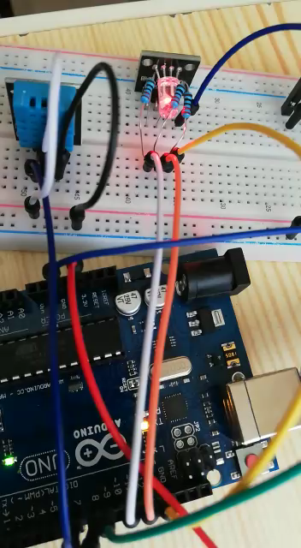
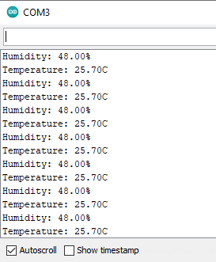
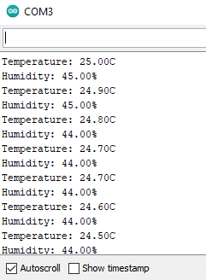
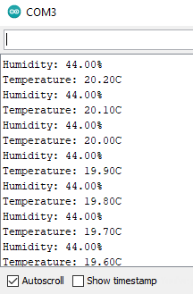
VIDEO

Slide 5
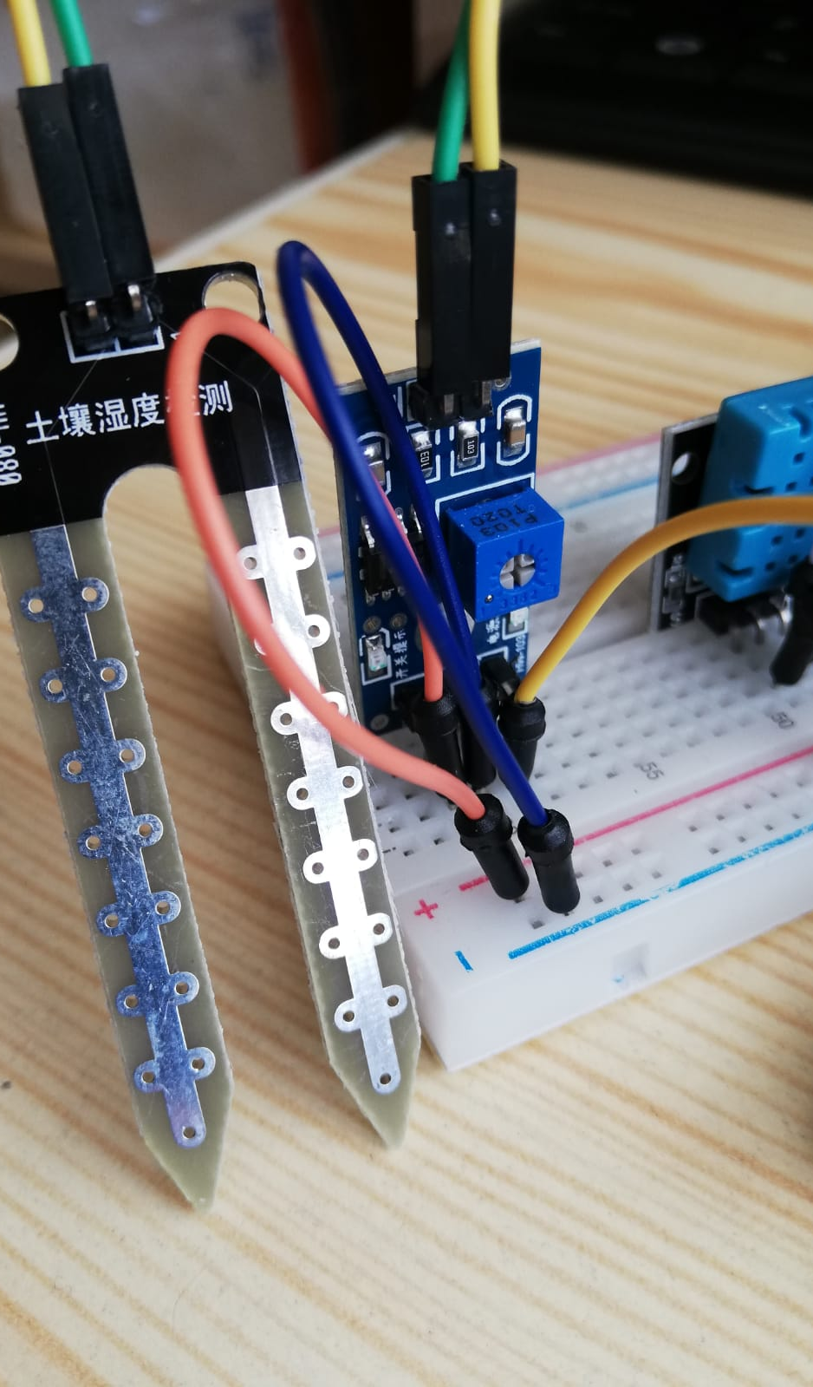
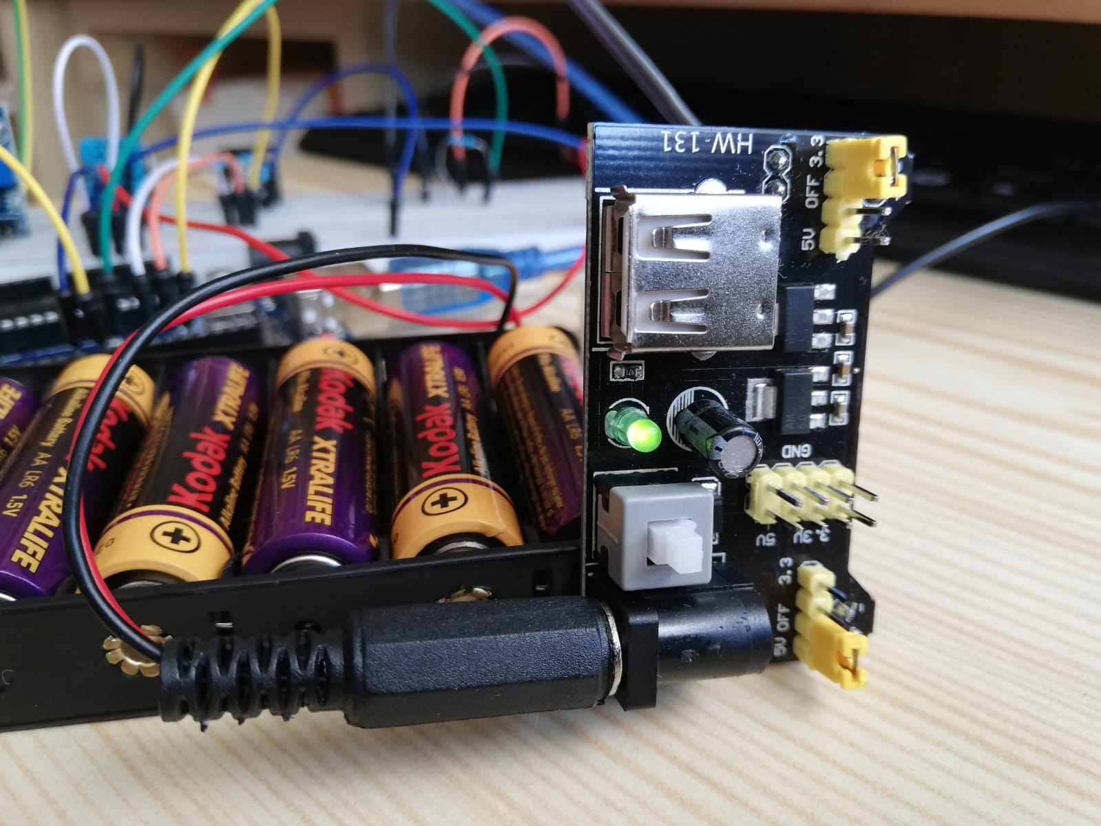
Because I wanted to use another sensor such as a soil moisture, I figured out that I should try to make an automated greenhouse and with the soil moisture I can turn on the pump and watering for example a flower.
I had to supply the pump and I tried with a mini power supply module HW-131. Also I need to use a transistor in order to permit a low power source (the Arduino output pin) to drive a high power demand (the pump).

Slide 6
During the laboratory classes at the faculty I’m still working on a room thermostat, but because I feel like I miss this practical phase, I wanted to do something. The part with the first sensor it was succeed, but turning the pump on while the soil moisture sensor measurements the moisture did not suceed.

